Slide 1

Introduction to Big Data: Unlocking the Power of Information
Exploring technologies and impacts of Big Data
Notes:
--- Big Data has transformed how we perceive and utilize information. This presentation will delve into the concept of Big Data, its technologies, applications, challenges, and future trends. By the end, you will understand how Big Data is shaping various sectors and its potential impact on society.

Slide 2

Agenda Items
Understanding Big Data
Big Data Technologies and Tools
Applications of Big Data
Challenges and Considerations
Future Trends in Big Data
Notes:
We'll start with an understanding of Big Data, covering its definition and unique characteristics. Then, we'll explore the technologies that power Big Data analytics and its diverse applications across industries. Following that, we will discuss the challenges and considerations involved in managing Big Data, and finally, we will look at future trends that will shape the landscape of Big Data.

Slide 3
Understanding Big Data
Notes:
Big Data encompasses vast amounts of data generated from various sources. Understanding its definition and key characteristics is crucial for leveraging its potential effectively.

Slide 4
What is Big Data?
Big Data refers to extremely large and complex datasets that traditional data processing tools and techniques are inadequate to handle efficiently. It encompasses the data itself, as well as the tools, technologies, and methods used to analyze, manage, and extract value from that data.

Slide 5

Definition and Characteristics of Big Data
What is Big Data?
Big Data refers to vast datasets that exceed the processing capabilities of traditional data tools, requiring advanced analytics.
Volume
The volume aspect of Big Data indicates the massive amounts of data generated every second, necessitating specialized storage solutions.
Velocity
Velocity refers to the speed at which new data is generated and processed, affecting the timeliness of decision-making.
Variety
Variety highlights the diverse types of data, including structured, unstructured, and semi-structured data from various sources.
Notes:
Big Data refers to datasets that are too large or complex for traditional data-processing software to handle efficiently. Characteristics include volume, velocity, variety, veracity, and value, which are essential for understanding its implications.

Slide 6
The 5 V’s of Big Data
Volume – Huge amounts of data Velocity – Rapid generation and flow Variety – Diverse data types and sources Veracity – Ensuring data quality Value – Extracting insights for impact

Slide 7
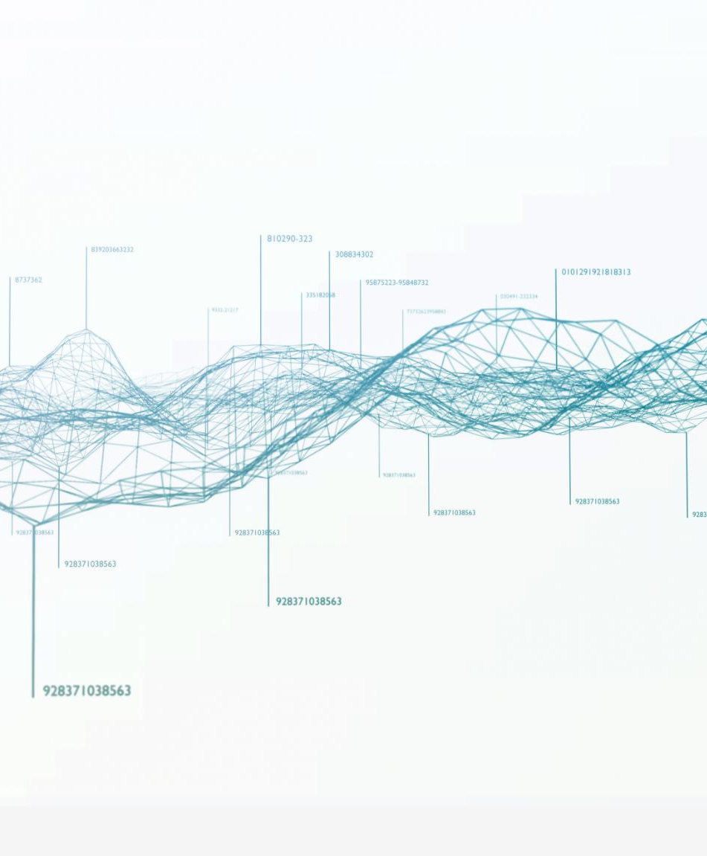
Evolution and History of Big Data
Technological Advancements
The evolution of Big Data has been significantly influenced by rapid advancements in technology, enabling better data processing and storage solutions.
Data Generation Growth
The exponential growth of data generation has been a driving force behind the rise of Big Data, impacting various sectors globally.
Current State of Analytics
Understanding the evolution of Big Data enhances our appreciation for today's data management techniques and analytics capabilities.
Notes:
The concept of Big Data has evolved over decades, driven by advancements in technology and the exponential growth of data generation. Understanding this evolution helps us appreciate the current state of data management and analytics.

Slide 8
Big Data Technologies and Tools
Notes:
Various technologies and tools facilitate the storage, processing, and analysis of Big Data. Knowing these technologies is vital for anyone looking to work in data science or analytics.

Slide 9

Data Storage and Processing Frameworks (Hadoop, Spark)
Hadoop Framework
Hadoop is designed for distributed storage of Big Data, enabling efficient handling of large datasets across multiple servers.
Spark Framework
Spark provides in-memory processing capabilities, significantly increasing the speed and efficiency of data analysis compared to traditional methods.
Big Data Analysis
Together, Hadoop and Spark represent powerful solutions for Big Data storage and processing, catering to diverse analytical needs.
Notes:
Hadoop and Spark are prominent frameworks for storing and processing Big Data. Hadoop utilizes distributed storage, while Spark offers in-memory processing, which enhances speed and efficiency for data analysis.

Slide 10
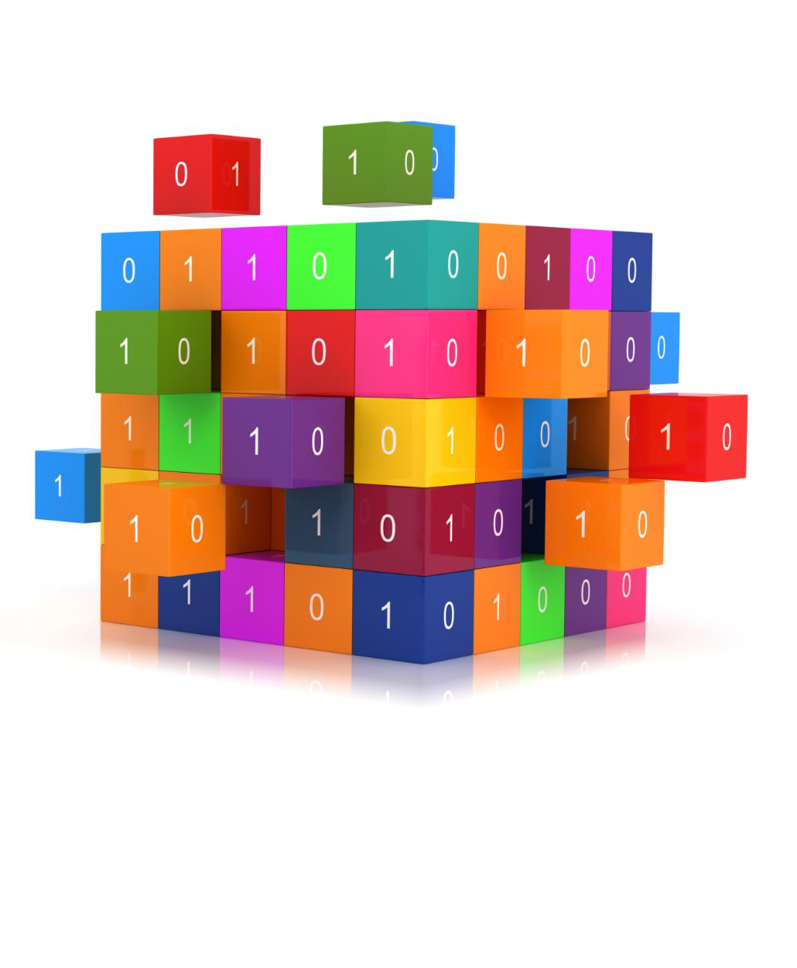
Database Management Systems (NoSQL, SQL)
Role in Big Data
Database management systems are essential for effectively managing and processing large volumes of Big Data in various applications.
NoSQL Databases
NoSQL databases are optimized for handling unstructured data and allow for horizontal scaling, making them suitable for big data applications.
SQL Databases
SQL databases excel in managing structured data and performing complex queries, crucial for applications requiring data integrity and relationships.
Notes:
Database management systems play a crucial role in handling Big Data. NoSQL databases are designed for unstructured data and horizontal scaling, while SQL databases are efficient for structured data and complex queries.

Slide 11

Data Analytics and Visualization Tools
Transforming Raw Data
Data analytics tools convert raw data into meaningful information, enabling informed decision-making in various sectors.
Visualization Tools Overview
Visualization tools like Tableau and Power BI help present complex data in a user-friendly format, enhancing understanding.
Actionable Insights
Using analytics tools, organizations can derive actionable insights that drive strategic initiatives and improve performance.
Notes:
Data analytics and visualization tools help transform raw data into actionable insights. Tools like Tableau and Power BI are widely used for visualizing complex data sets in an easily digestible format.

Slide 12
Applications of Big Data
Notes:
Big Data has numerous applications across various sectors, enabling organizations to make informed decisions based on data-driven insights. Let's take a look at some of these applications.

Slide 13

Business Intelligence and Decision Making
Enhanced Decision-Making
Big Data analytics provides valuable insights that significantly enhance the decision-making processes in businesses.
Market Trends Analysis
Analyzing market trends through data allows businesses to adapt their strategies and stay competitive.
Customer Behavior Insights
Understanding customer behavior through analytics helps businesses tailor their offerings to meet customer needs effectively.
Operational Efficiency
Big Data analytics drives operational efficiency by identifying areas for improvement and streamlining processes.
Notes:
In business, Big Data analytics enhances decision-making processes by providing insights into market trends, customer behavior, and operational efficiency, driving strategic initiatives.

Slide 14

Healthcare and Medical Research
Improving Patient Care
Big Data enhances patient care by enabling personalized treatment plans and better management of health outcomes.
Predicting Outbreaks
Big Data analytics helps in predicting disease outbreaks by analyzing trends and patterns in health data.
Conducting Medical Research
By analyzing vast datasets from clinical trials, Big Data significantly advances the field of medical research.
Notes:
In healthcare, Big Data plays a pivotal role in improving patient care, predicting outbreaks, and conducting medical research by analyzing vast datasets from clinical trials and patient records.

Slide 15

Government and Public Services
Big Data Utilization
Governments leverage Big Data to enhance their public services and meet the evolving demands of citizens effectively.
Security Enhancement
Using data analytics, governments can improve security measures and respond swiftly to potential threats or emergencies.
Resource Optimization
Analyzing data allows governments to allocate resources more effectively, ensuring better service delivery and efficiency.
Effective Policy-Making
Data analysis supports informed decision-making, enabling policymakers to craft better responses to citizens' needs.
Notes:
Governments utilize Big Data to improve public services, enhance security, and optimize resource allocation. Analyzing data helps in policy-making and responding to citizens' needs effectively.

Slide 16
Challenges and Considerations
Notes:
Despite its advantages, Big Data presents several challenges that organizations must navigate. Understanding these challenges is crucial for effective data management.

Slide 17

Data Privacy and Security
Importance of Data Privacy
Protecting sensitive information is crucial for maintaining trust and compliance with regulations in today's digital world.
Regulatory Compliance
Organizations must comply with various regulations to ensure data privacy and protect user information from breaches.
Robust Security Measures
Implementing strong security measures is essential to safeguard data integrity and prevent unauthorized access.
Notes:
With vast amounts of sensitive data, ensuring privacy and security is paramount. Organizations must comply with regulations and implement robust security measures to protect data integrity.

Slide 18

Data Quality and Management
Importance of Data Quality
High data quality is vital for accurate analysis and informed decision-making in organizations.
Effective Data Management Strategies
Organizations must adopt effective data management strategies to ensure data integrity and reliability.
Ensuring Data Completeness
Data completeness is essential to avoid gaps that can lead to misleading analysis results.
Notes:
Maintaining data quality is crucial for accurate analysis. Organizations need effective data management strategies to ensure data is accurate, complete, and reliable before analysis.

Slide 19

Ethical and Legal Implications
Data Ownership
The question of who owns the data collected is central to ethical discussions about Big Data use and management.
Informed Consent
Obtaining informed consent from users is essential to adhere to legal standards and ethical practices in data collection.
Public Trust
Maintaining public trust is crucial for organizations using Big Data; transparency and ethical practices can foster this trust.
Notes:
The use of Big Data raises ethical and legal concerns, including data ownership and consent. Organizations must consider these implications to avoid legal repercussions and maintain public trust.

Slide 20
Future Trends in Big Data
Notes:
As technology evolves, so does Big Data. Understanding future trends will prepare organizations for the next wave of data innovation and its potential applications.

Slide 21

Advancements in Artificial Intelligence and Machine Learning
AI and Big Data Integration
The integration of AI with Big Data analytics enhances the ability to process and analyze vast amounts of data effectively.
Enhanced Data Processing
AI and machine learning technologies significantly improve data processing capabilities, leading to better decision-making.
Deeper Insights and Predictions
Organizations can derive deeper insights and make accurate predictions from large datasets through advanced AI techniques.
Notes:
The integration of AI and machine learning with Big Data analytics will enhance data processing capabilities, enabling organizations to derive deeper insights and predictions from large datasets.

Slide 22
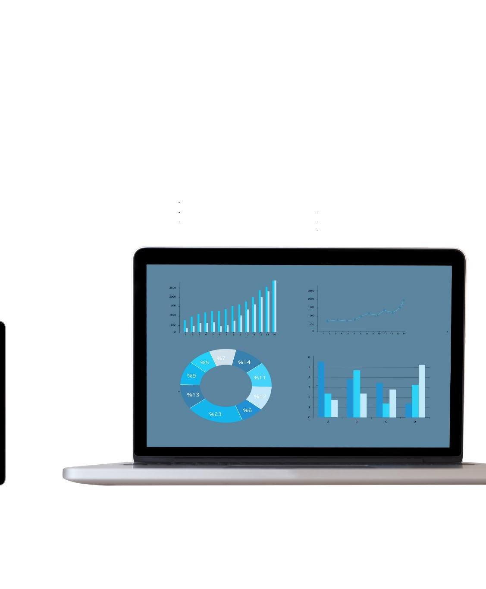
Integration with Internet of Things (IoT)
Data Streams from IoT
The IoT generates vast amounts of data from connected devices, enabling unprecedented insights into user behavior and system performance.
Real-Time Decision-Making
Integrating IoT with Big Data analytics allows organizations to make data-driven decisions in real-time, enhancing operational efficiency.
Revolutionizing Data Utilization
This integration revolutionizes how data is utilized, transforming it into actionable insights that drive innovation and efficiency.
Notes:
The rise of IoT generates massive streams of data from connected devices. Integrating IoT with Big Data analytics will revolutionize data utilization in real-time decision-making.

Slide 23

The Role of Big Data in Smart Cities
Improving Urban Living
Big Data provides valuable insights that help enhance living conditions in urban areas through better resource management.
Enhancing Public Services
Data-driven insights allow for more efficient public services, including transportation, healthcare, and waste management.
Promoting Sustainability
Big Data plays a vital role in promoting sustainable practices, helping cities reduce their environmental impact.
Notes:
Big Data is essential in the development of smart cities, where data-driven insights improve urban living conditions, enhance public services, and promote sustainable practices.

Slide 24
Conclusion
Potential of Big Data
Big Data can transform various industries by providing insights that were previously unattainable.
Challenges in Big Data
Despite its potential, Big Data presents challenges such as data privacy, security, and interpretation that need to be managed.
Responsible Use of Data
Embracing Big Data responsibly enables organizations to derive valuable insights while maintaining ethical standards.
Driving Innovation
Organizations that effectively leverage Big Data can drive innovation and enhance decision-making processes.
Notes:
Big Data holds immense potential across various fields, but it also comes with challenges that must be addressed. By embracing Big Data responsibly, organizations can unlock valuable insights that drive innovation and improve lives.

